Slide 1
Estimating Simulation Demand
Roberto Miquel, AICP
Converting Demand Model Forecasts into Usable Data for Microsimulations
June 4, 2019

Slide 2


Acknowledgements
Ohio Department of Transportation
RSG
CDM Smith
TRB Planning Applications Conference

Slide 3
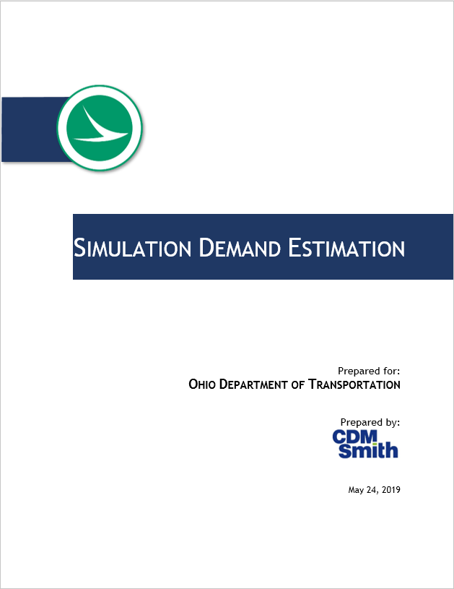
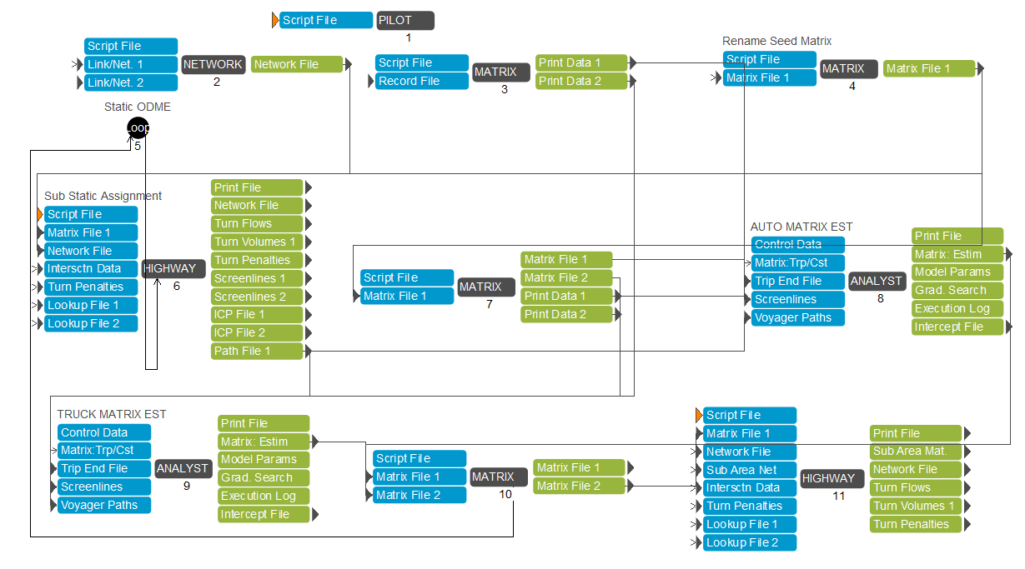
Overview
Methodological Guidance
  Guidance documented
  Supported techniques
  References to SDE tool
SDE Tool
  Primarily Cube-based tool
  Some supporting spreadsheets

Slide 4
Methodological Guidance
Support the process of traffic analysis using microsimulation (Synchro and TransModeler)
Intended to use travel demand model as starting point
Seeks to maintain consistency with ODOT’s forecasting procedures
Multi-step process that addresses: base year conditions, forecast year conditions, and project alternative networks
No
No further adjustments required to matrix
Develop future year forecast simulation matrix as per standard SDE procedure accounting for DHV as necessary.
Assign simulation matrix to network and compare flow to existing traffic for reasonableness
Is forecast too low?
Yes
Adjust DHV factor and apply to simulation matrix

Slide 5
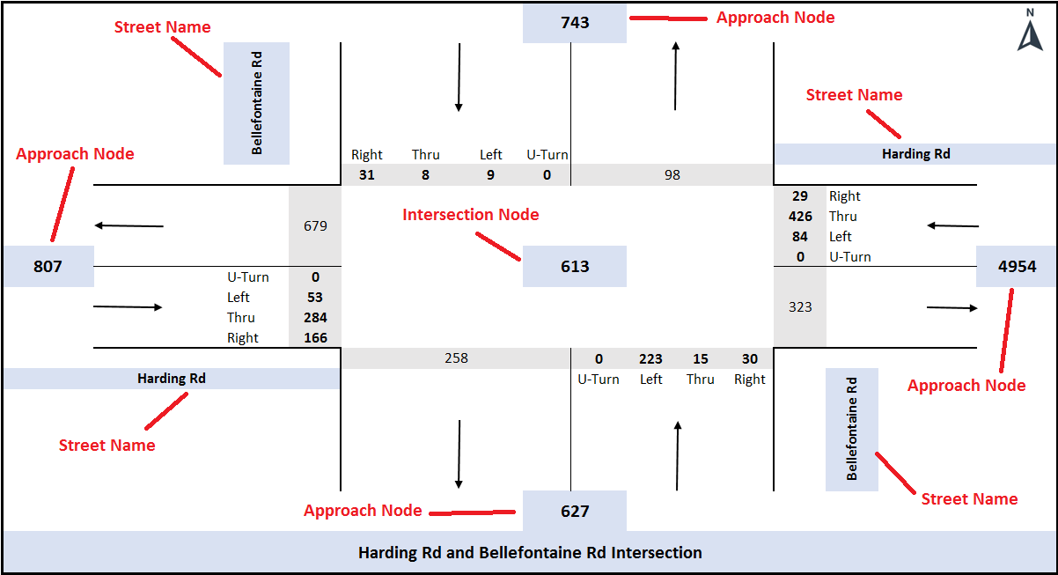
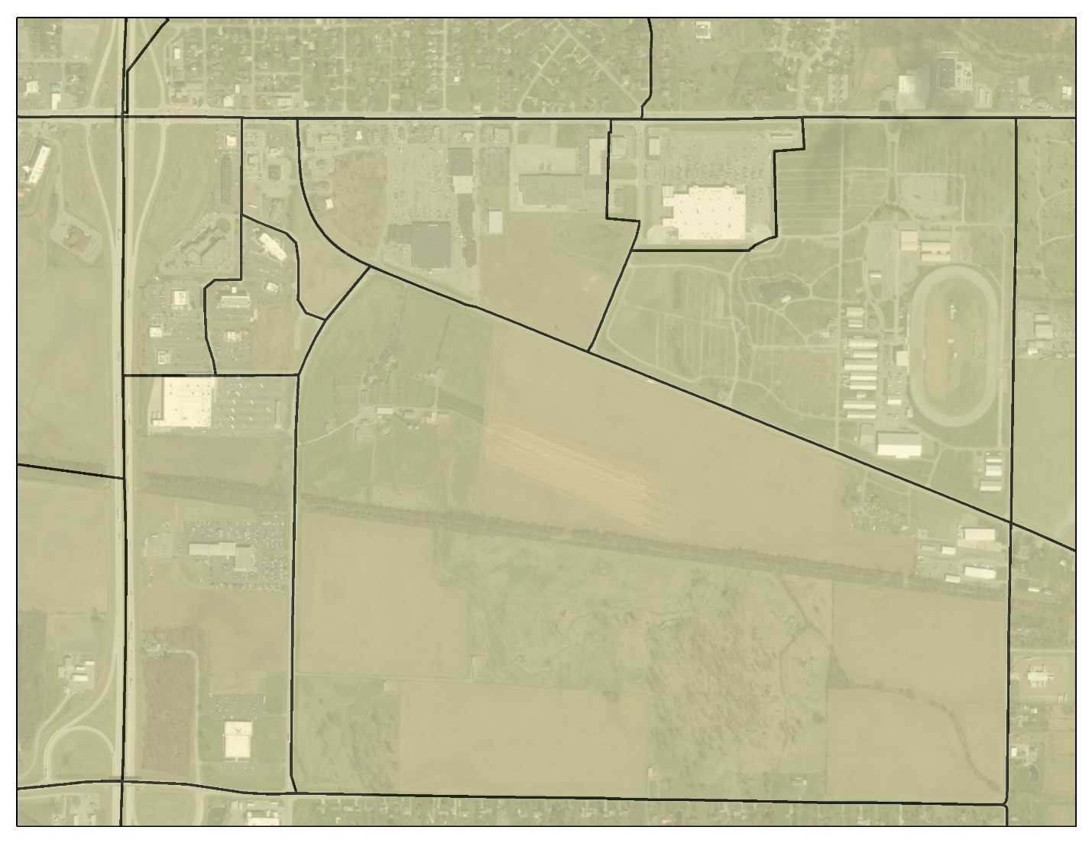
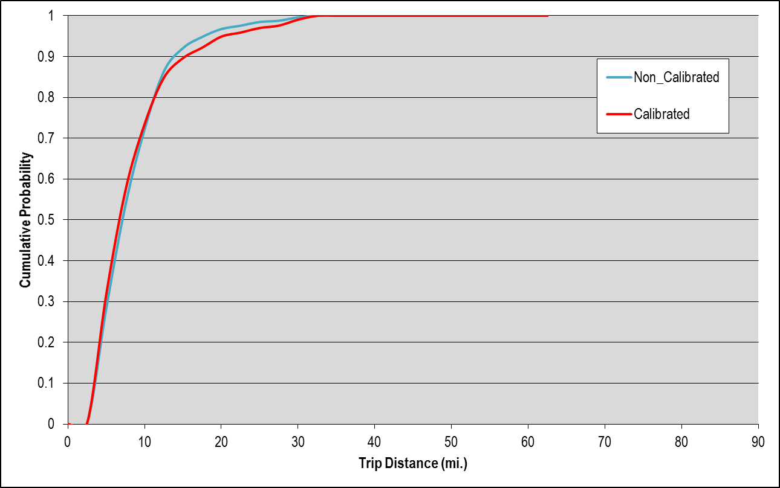
Methodological Guidance (cont.)
Documented procedures
  Model Checking and Refinement
  Project Specific Count Data
  Subarea Extraction
  Temporal Parsing of Data
  Period-level Matrix Estimation
  Hourly-level Matrix Estimation
  Conversion of Demand to TransModeler and Synchro
  Development of Simulation Network
  Project Alternative Networks
  Forecast Year Demand
New TAZ splits to accommodate traffic analysis network.

Slide 6
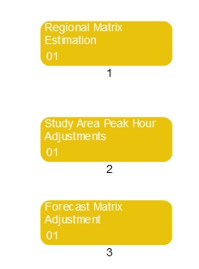
Simulation Demand Estimation (SDE) Tool
Tool is composed of three major components
  Regional Matrix Estimation
    Performs time period level matrix estimation.
    Regional model’s time period: AM, Midday and PM.
  Study Area Peak Hour Adjustments
    Performs hourly level matrix estimation.
    Uses hourly factors to convert demand to hourly.
  Forecast Matrix Adjustment
    Estimates future growth in OD trips.
    Develops hourly level OD demand for forecast year.

Slide 7
SDE Tool (cont.)
What it does:
  Read ODOT travel demand model data
  Extract subarea matrices based on user-defined networks for input to simulations
  Conducts matrix estimation at the regional / period-level
  Conducts matrix estimation at the subarea / hourly-level
  Link counts and turning movement counts
  Pivots estimated matrices to forecast conditions
What it does not do:
  Does not automatically create simulation networks
  Does not automatically create intersection inputs for simulation
  Supplemental spreadsheet tool available

Slide 8
Case Studies
Toledo Downtown Traffic Study
  Purpose: Evaluate existing, future, and proposed traffic flow for the downtown Toledo transportation plan
  0.6 square miles of downtown Toledo
  146 intersections (35 with turning movement counts)
Akron Summit 8
  Purpose: Support SR-8 corridor study in Akron with project-level OD matrices
  4.5 mile corridor
  29 intersections (all major intersections have counts)

Slide 9
Case Studies (cont.)
Run 2010 OMS and Check Validation
Prepare New Input
Run Project Base Year OMS and Study Area Validation
Matrix Estimation for Base Year Hourly Demand
Future Forecast

Slide 10
Case Studies (cont.)
Iterative Matrix Estimation
Update intersection files
Update link or turn counts
Rerun SDE step 1 and 2
Check matrix estimation validation statistics
Repeat until validation satisfied criteria
Double check study area validation
Model refinements

Slide 11
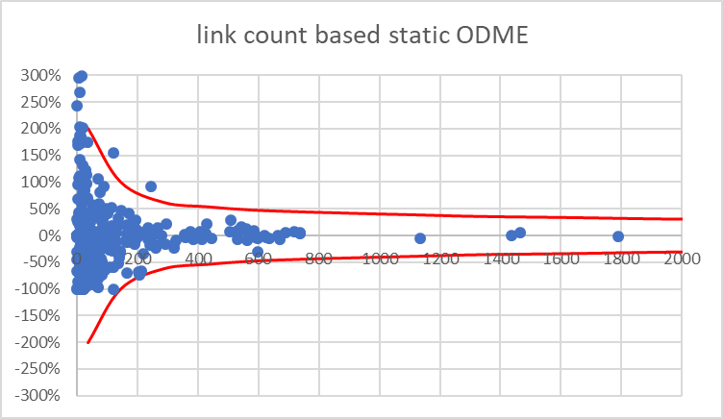
Case Studies (cont.)
Key takeaways:
  Validate models to project base year / existing condition
    Existing condition transportation facilities, traffic counts, intersections
    Make sure model runs to convergence
    Focus validation on study area, not entire regional model
  Collect hourly turning movement counts for matrix estimation
  Validate matrix estimation results
    GEH < 5; good
    5 ≤ GEH ≥ 10; review for potential error
    GEH > 10; refine model

Slide 12
Questions/Discussion

Slide 13
Contact Information:
Roberto Miquel, AICP
CDM Smith
5400 Glenwood Ave., Raleigh, NC 27612
miquelro@cdmsmith.com
919.325.3605
Jason Chen, Ph.D.
RSG
55 Railroad Row, White River Junction, VT 05001
Jason.Chen@rsginc.com
802.359.6431
Gregory T. Giaimo, P.E.
ODOT Office of Statewide Planning and Research
1980 W. Broad Street, MS 3280 Columbus, OH 43223
Greg.Giaimo@dot.ohio.gov
614.752. 5738

